Slide 1
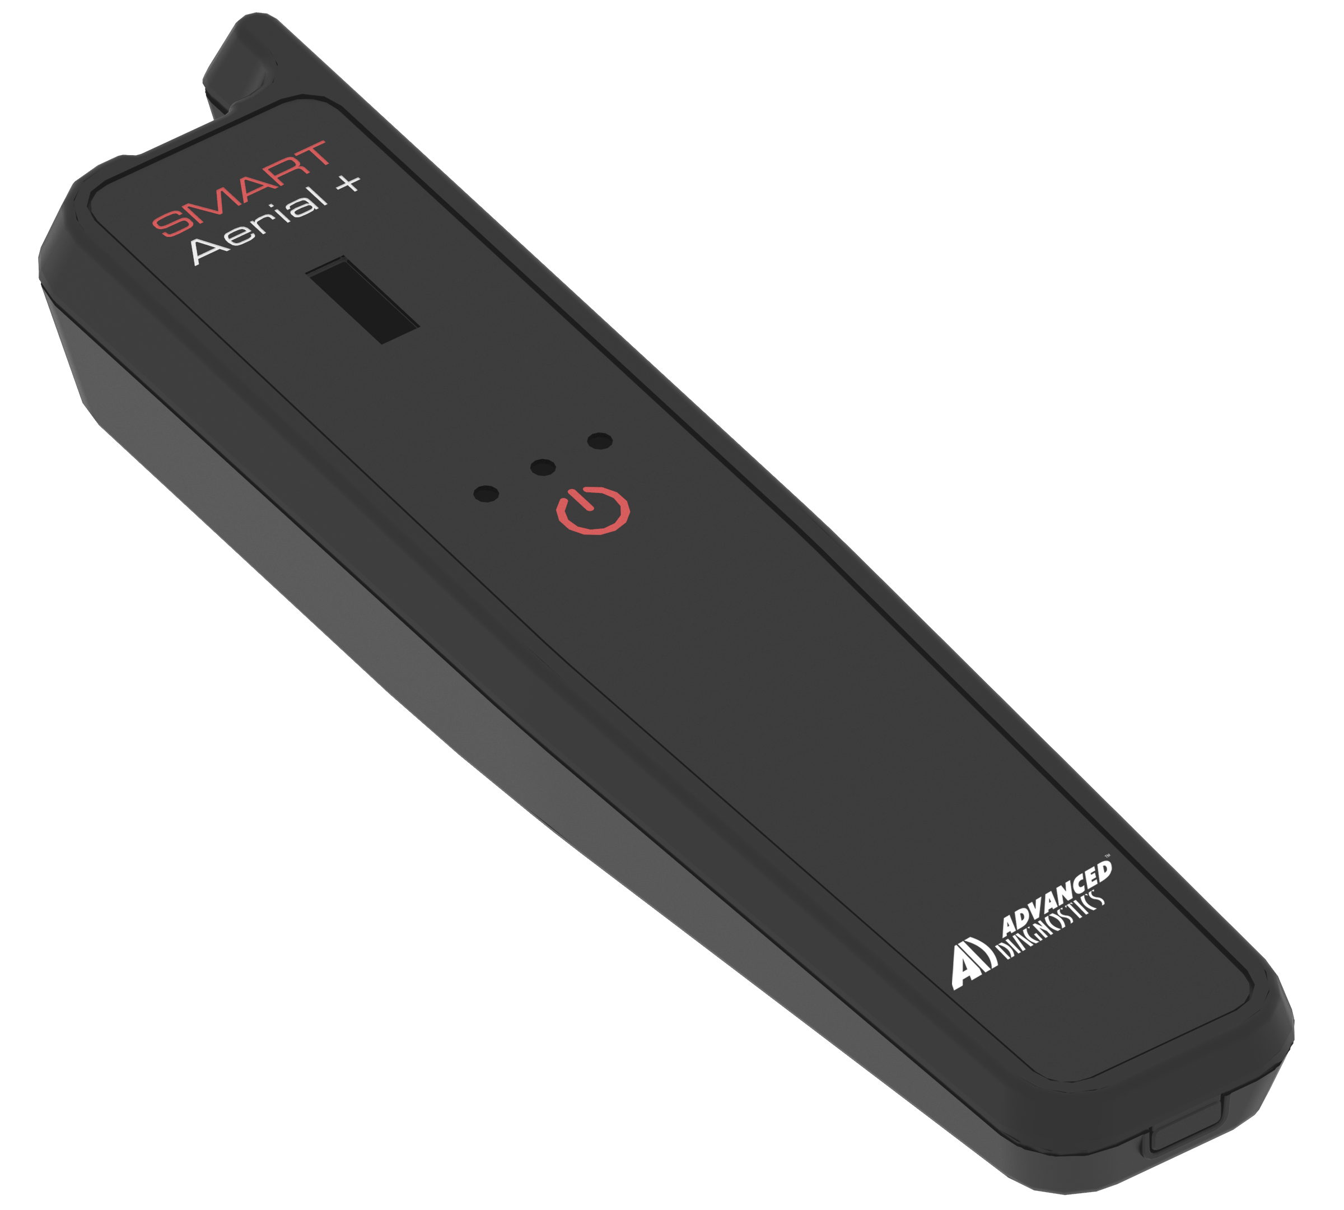
Cloud Cloning Solution Smart Aerial +
Revision 03
27 May 2022

Slide 2
Customer Value Proposition
Cloud Cloning Solution - Smart Aerial+
The Smart Aerial+ from Advanced Diagnostics is the low investment, easy to use cloning device, ideal for delivering a reliable, no-nonsense key duplication service to the consumer.

Slide 3
Key features
Cloud Cloning Solution - Smart Aerial+
New “Smart” Cloud cloning device with intuitive software associated to MYKEYS Pro.
Integrated into the MYKEYS Pro support ecosystem.
Updateable with new functionality in the future.
Flexible transponder pricing. With the new transponder, GTI-Pro.
Lightweight, portable device with internal, rechargeable battery (USB cable and mains charging cable with a universal AC adaptor).
WiFi and Bluetooth connectivity.
U-Snoop functions integrated.
New cloning capability for Mazda (8C Temic, not available for RW4).
Transponder pre-setting function.
Compatible with all existing Silca cloning capabilities.
Certified CE, UKCA, FCC,RHOSS,RAE.

Slide 4
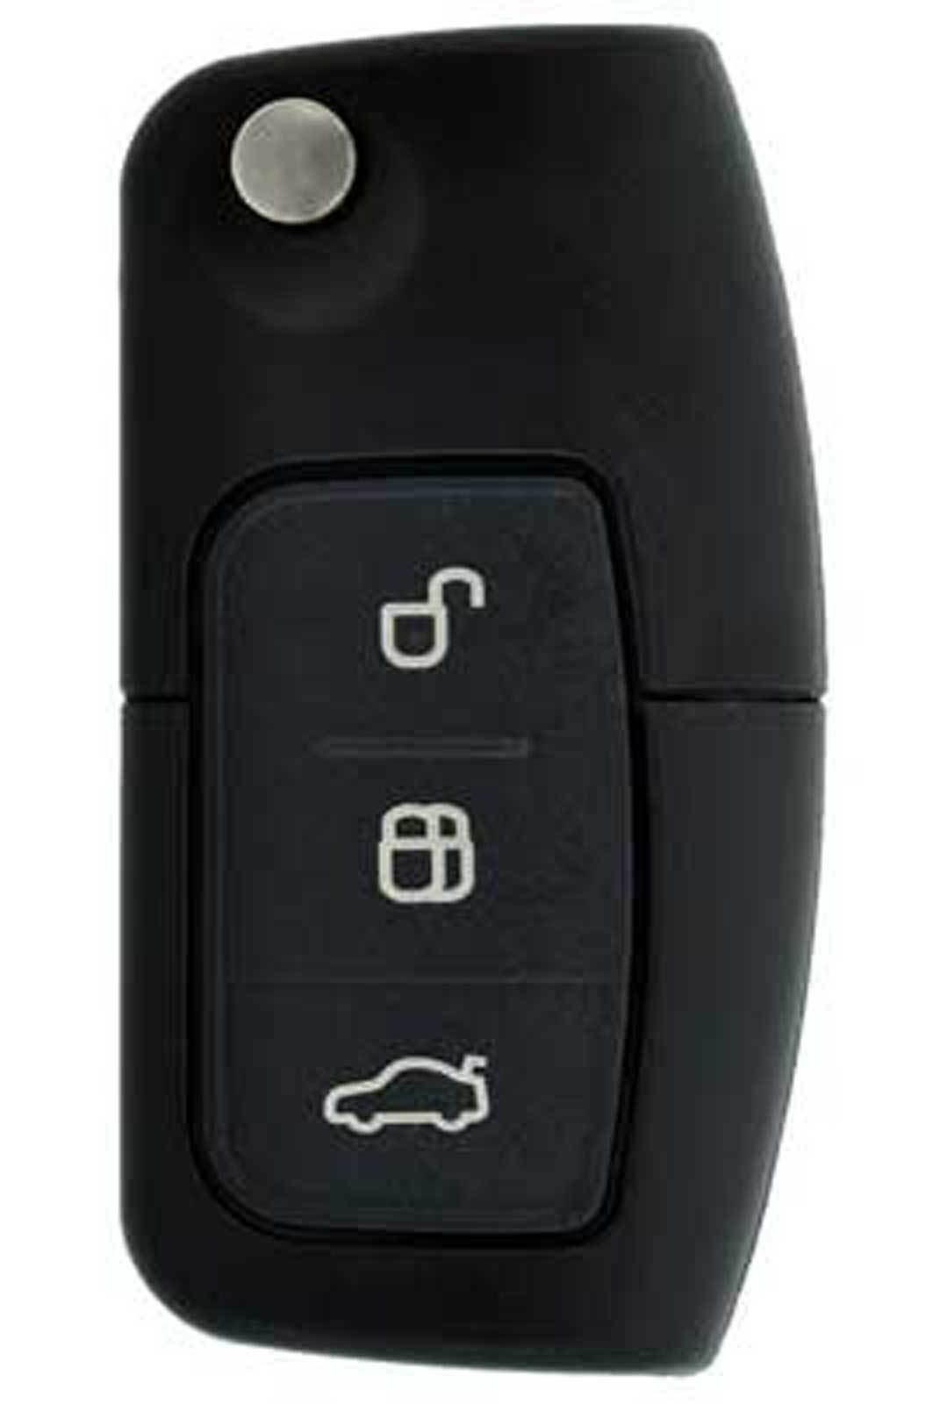
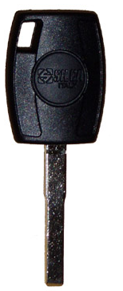
Cloning process summary
Cloud Cloning Solution - Smart Aerial+
Cloud Super Computer
1
2
4
3
1
Smart Aerial+ reads original key
2
Data sent to cloud for calculation
4
Transponder is cloned to create a new key
3
Cloning data sent back to Smart Aerial+
4

Slide 5
Cloning product range summary
Cloud Cloning Solution - Smart Aerial+
Smart Aerial +
GTI-Pro (C109012)
Trp Code | Technology
GTI-W | Multi Trp.
T49C | Honda G
T80+ | DST80
T128C | Toyota H
8C | Temic Mazda
T5 | Temic ID 11,12,13,33
New device connect with MKP to guide the customer through the cloning process.
Wi-Fi connectivity to the internet.
All cloning calculations done via cloud.
SNOOP function integrated.
Transponder generation.
Compatibile with GTI-Pro.
5

Slide 6
Notes
Original smart aerial functions will be added to smart aerial+ around November
Cloning functions are stand alone
Original SA functions done on Smart Pro as before via USB connection

